Slide 1
translationRecorder v1.2.4
Starting a new project

Slide 2
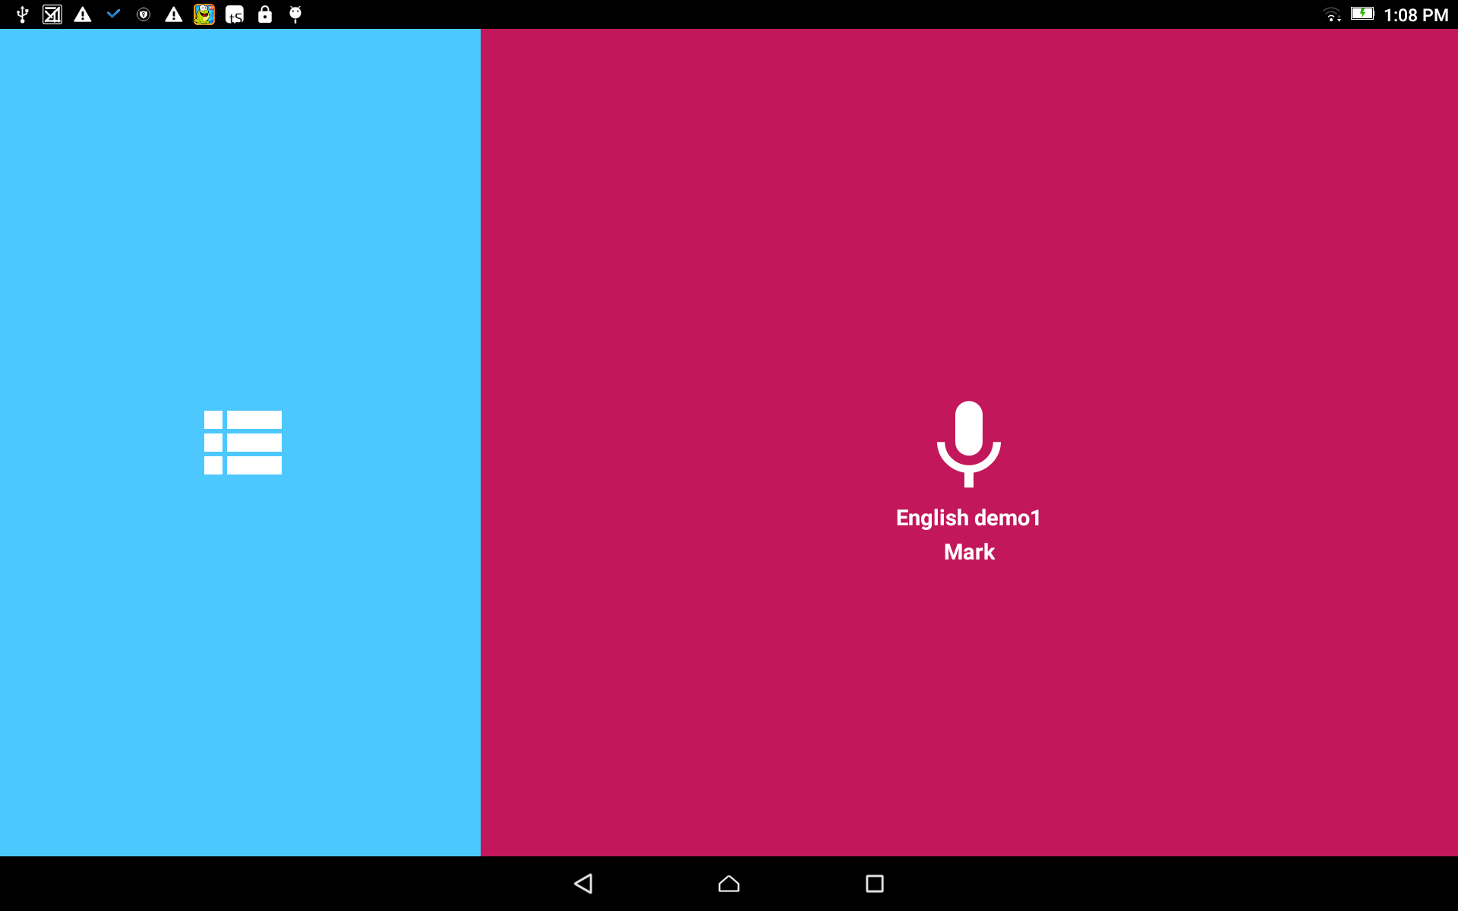
Start a Project:
From the home screen, tap in the blue area to open the Project Manager.

Slide 3
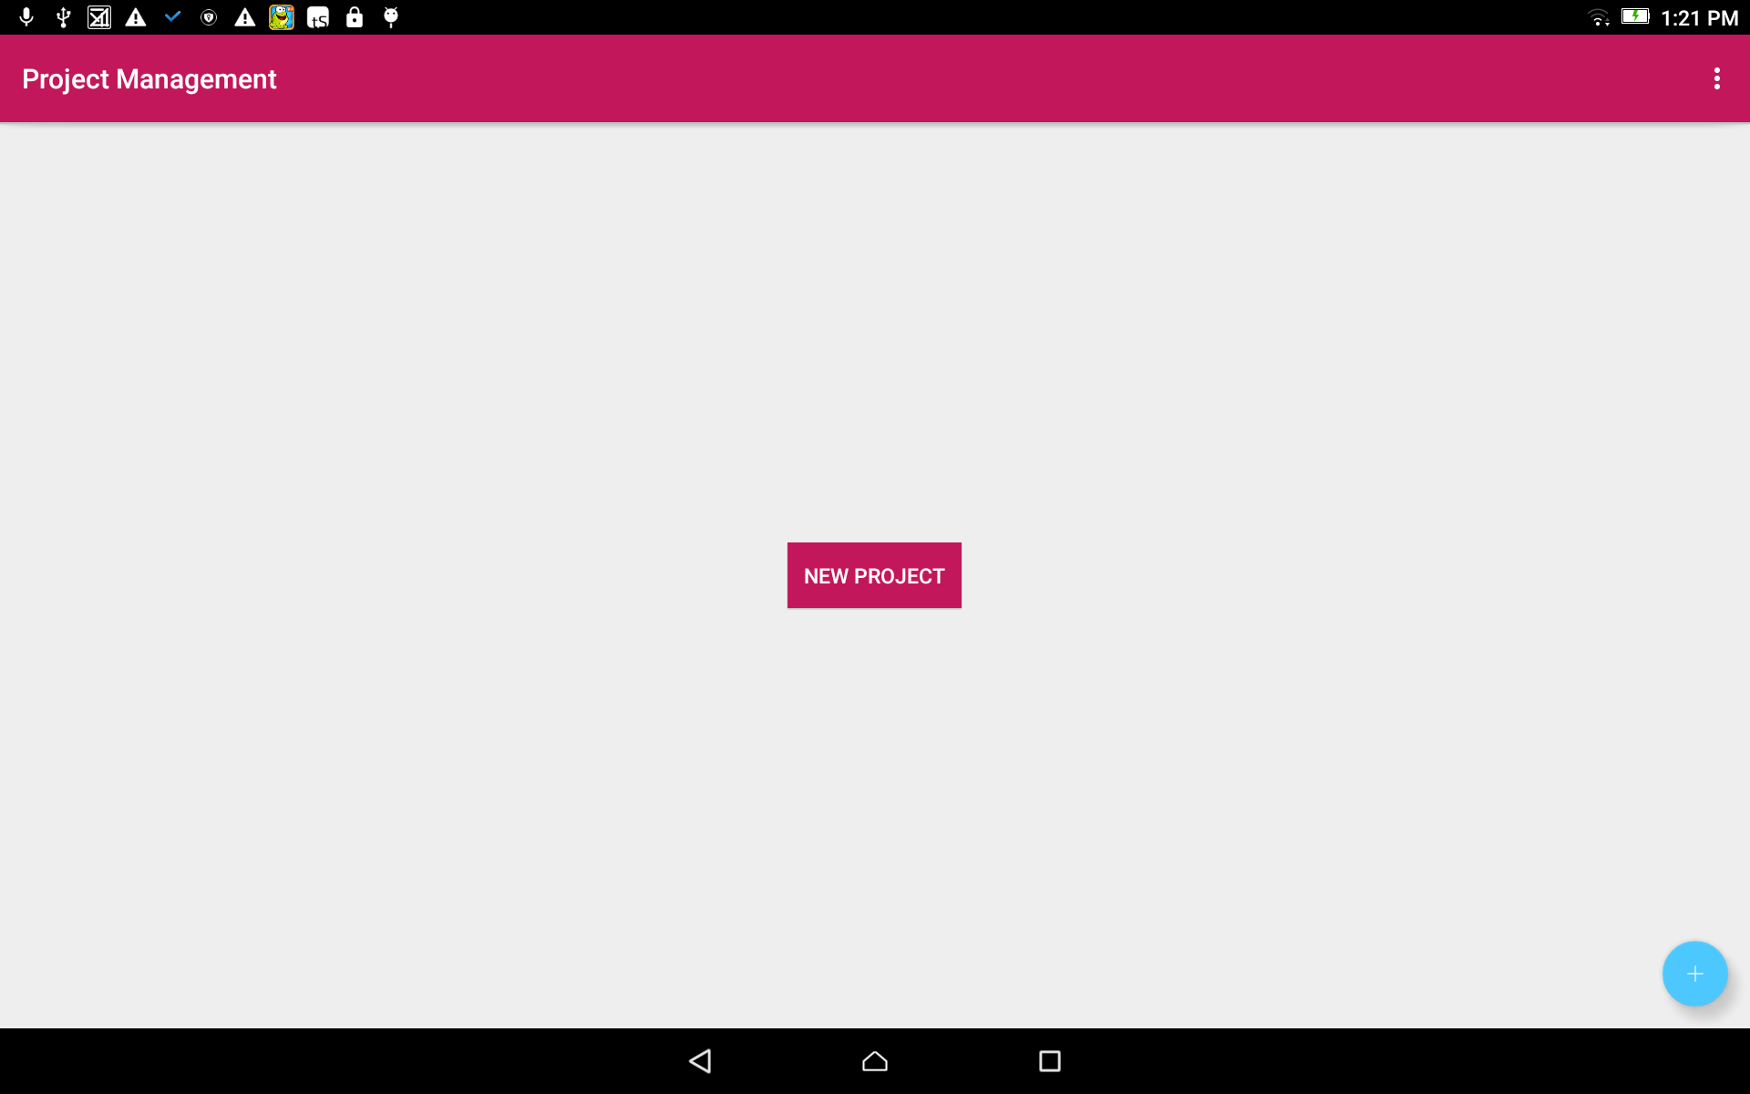
Create a new project:
Tap on the blue circle with a white plus sign.

Slide 4
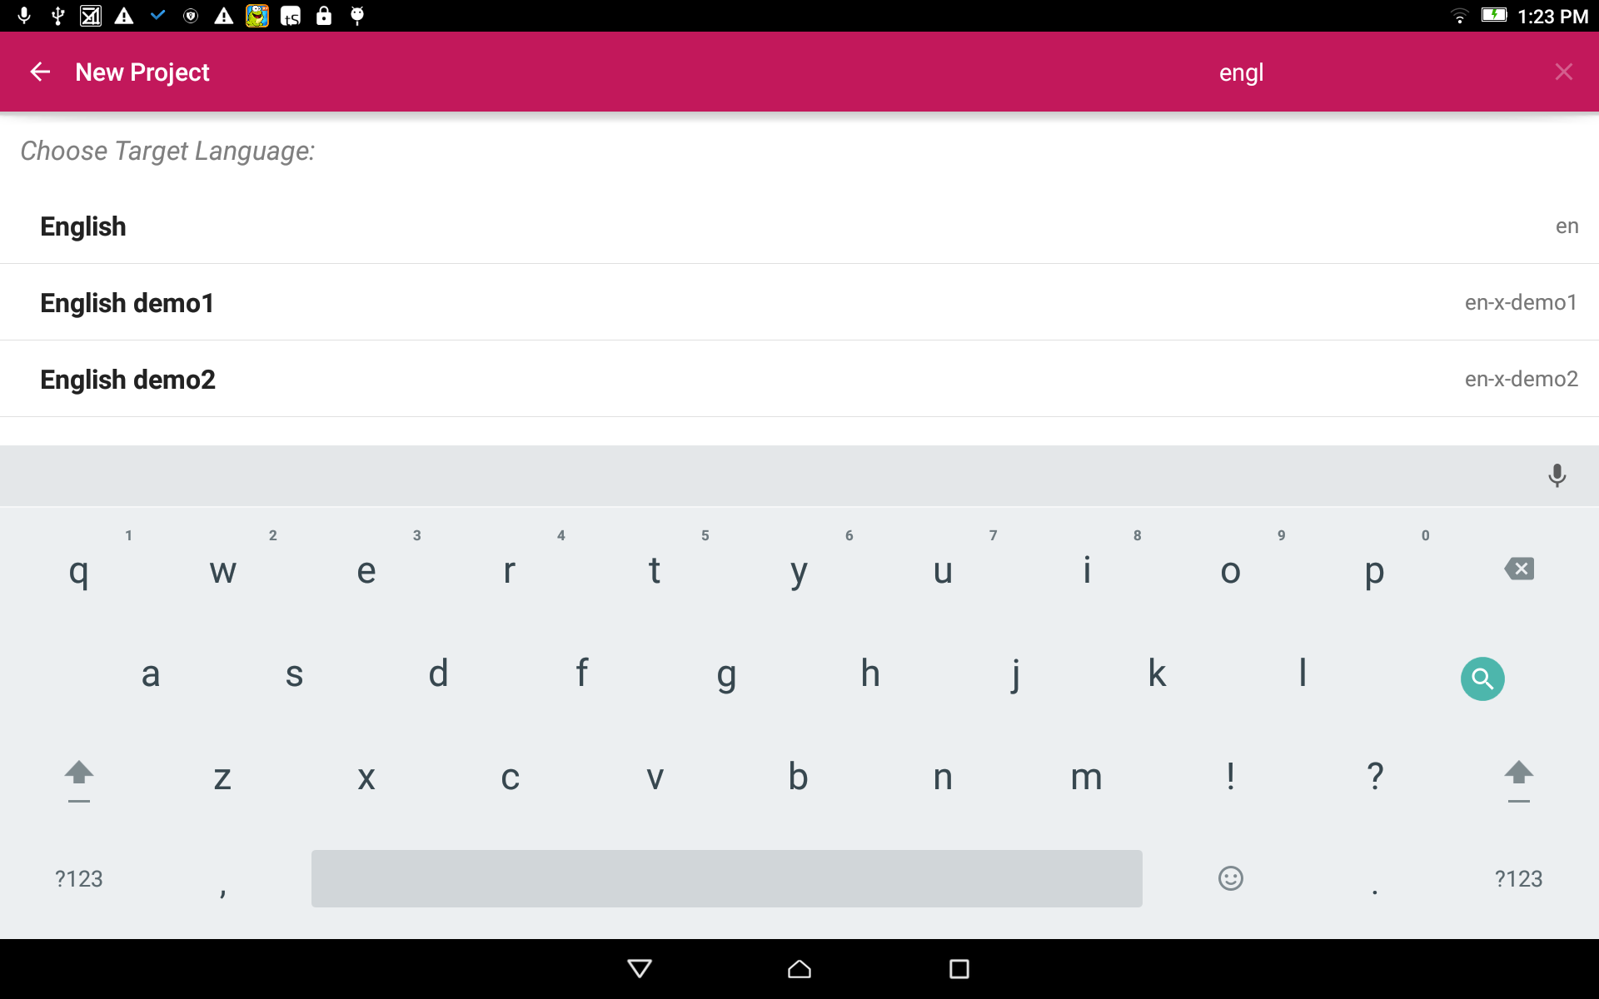
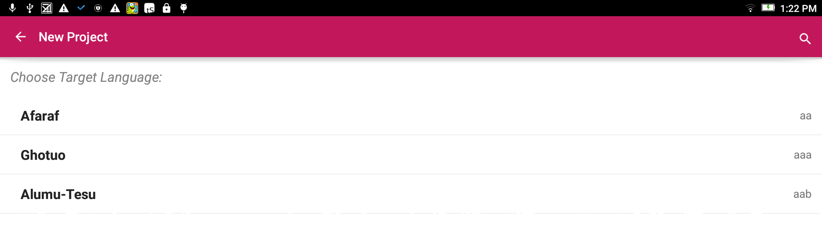


Select the Target Language:
The Target Language is the language into which you will translate.
Search for the desired language by either:
Scrolling to the language name.
OR
Clicking the magnifying glass and typing in the language name or language code.

Slide 5
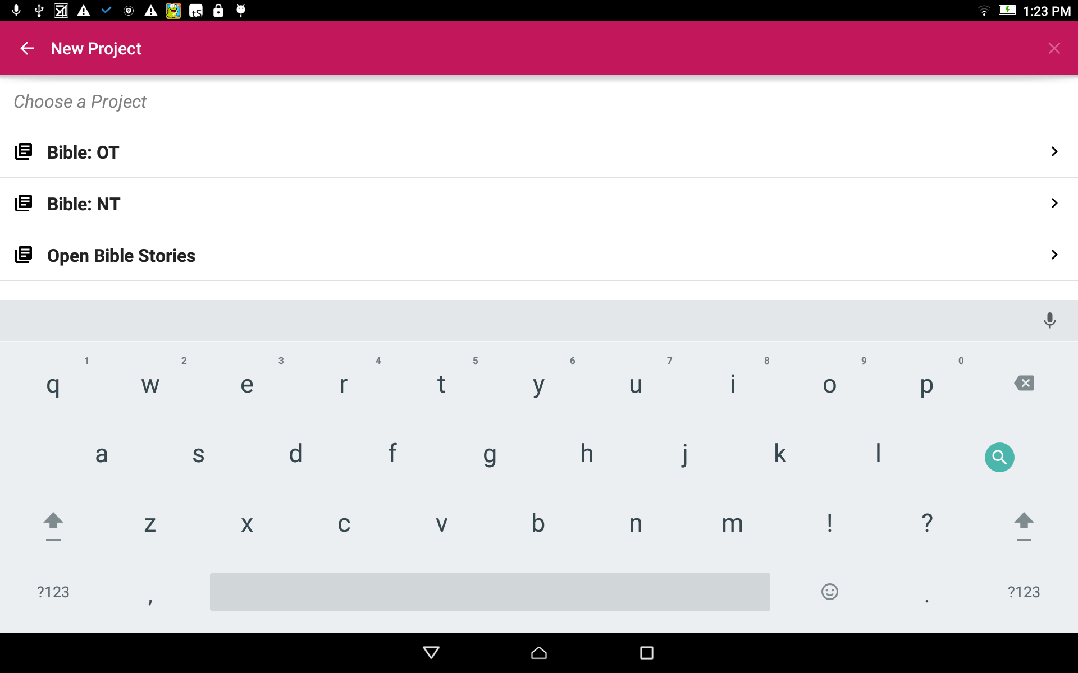
Choose a Project:
Tap on the words to choose to start a OT, NT or Open Bible Stories project.

Slide 6
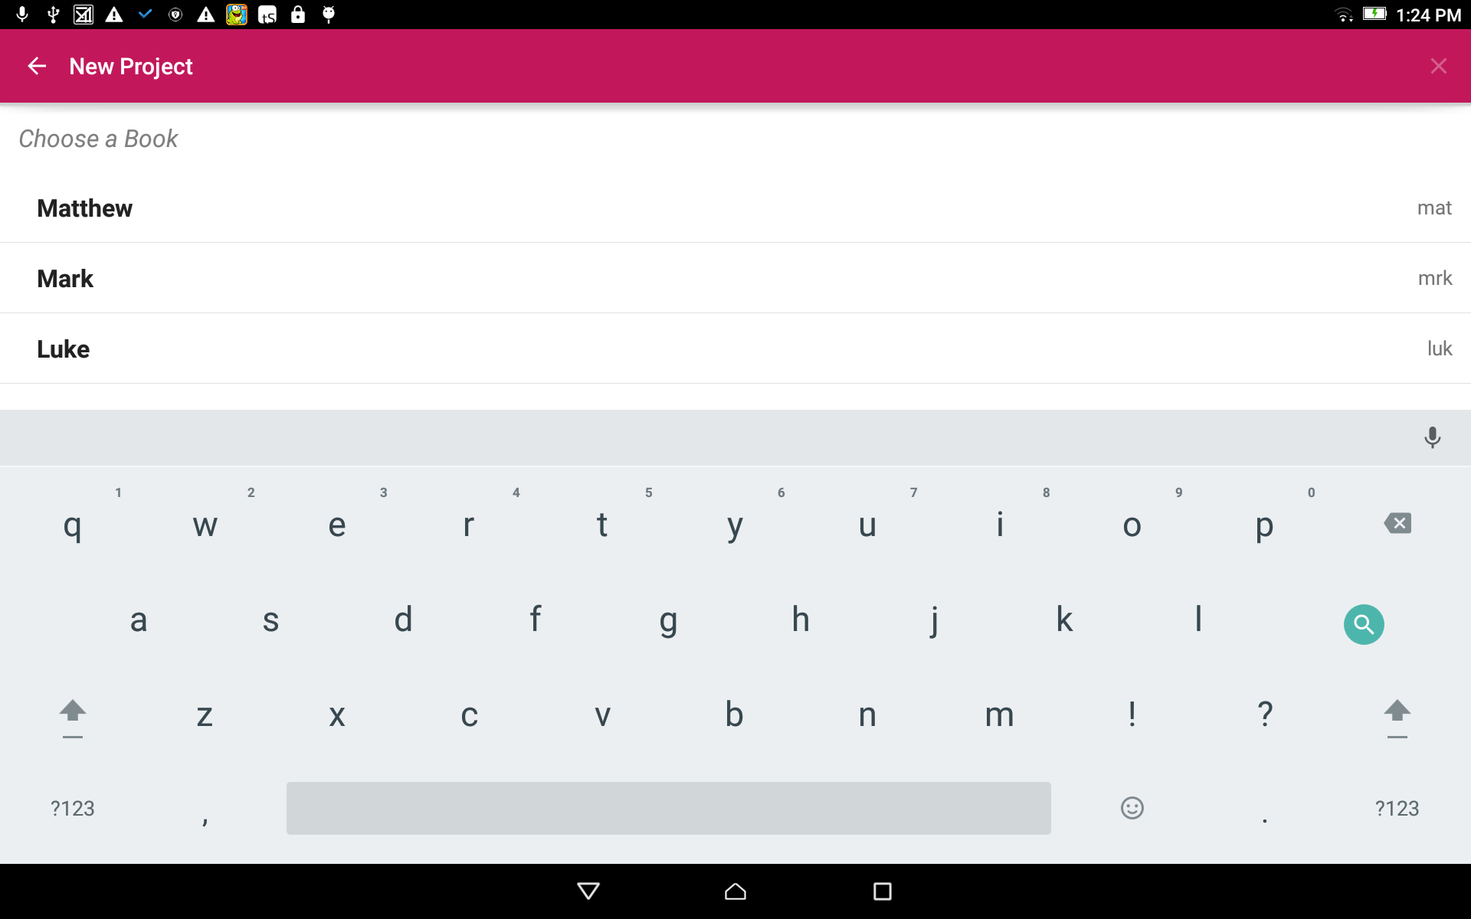
Choose a Book:
Tap on the book title to choose a book for the project.
Scroll down for books later in the testament.

Slide 7
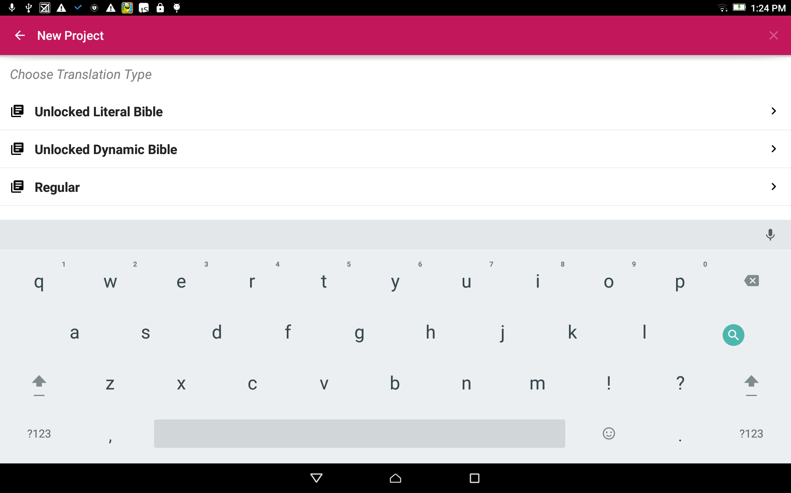
Choose a Translation Type:
The translation type is the type of translation of the final project work.
Tap on the words to choose a translation type.

Slide 8
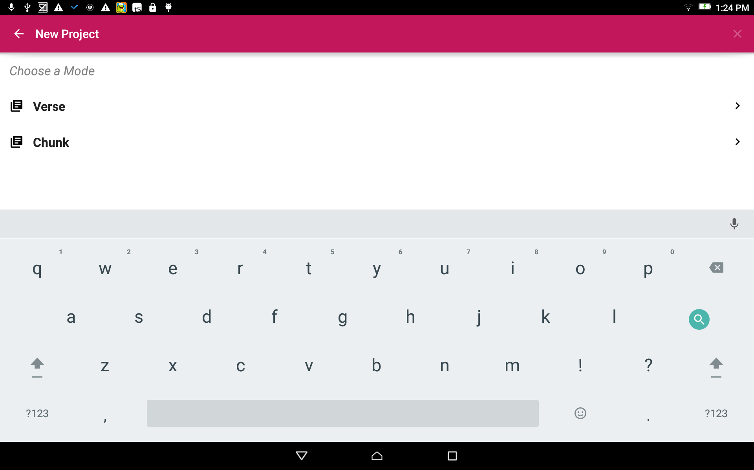
Choose a Mode:
Tap to choose either Verse or Chunk mode. This is how the information will be divided.

Slide 9
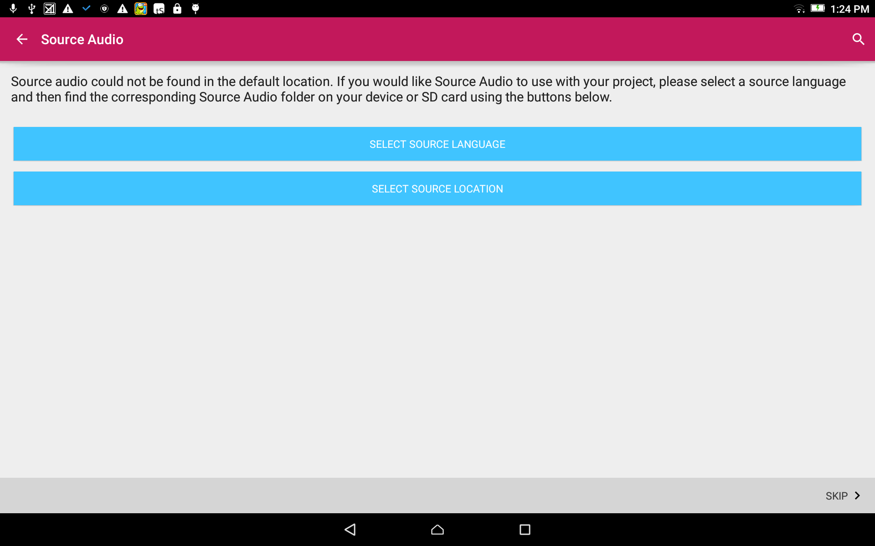
Source Audio Selection:
The Source Language is the language from which you will translate.
Tap on the top blue bar (Select Source Language).
Skip this step if not using a source text
Skip steps for source audio
Notes:
If not using source audio skip to slide 14

Slide 10
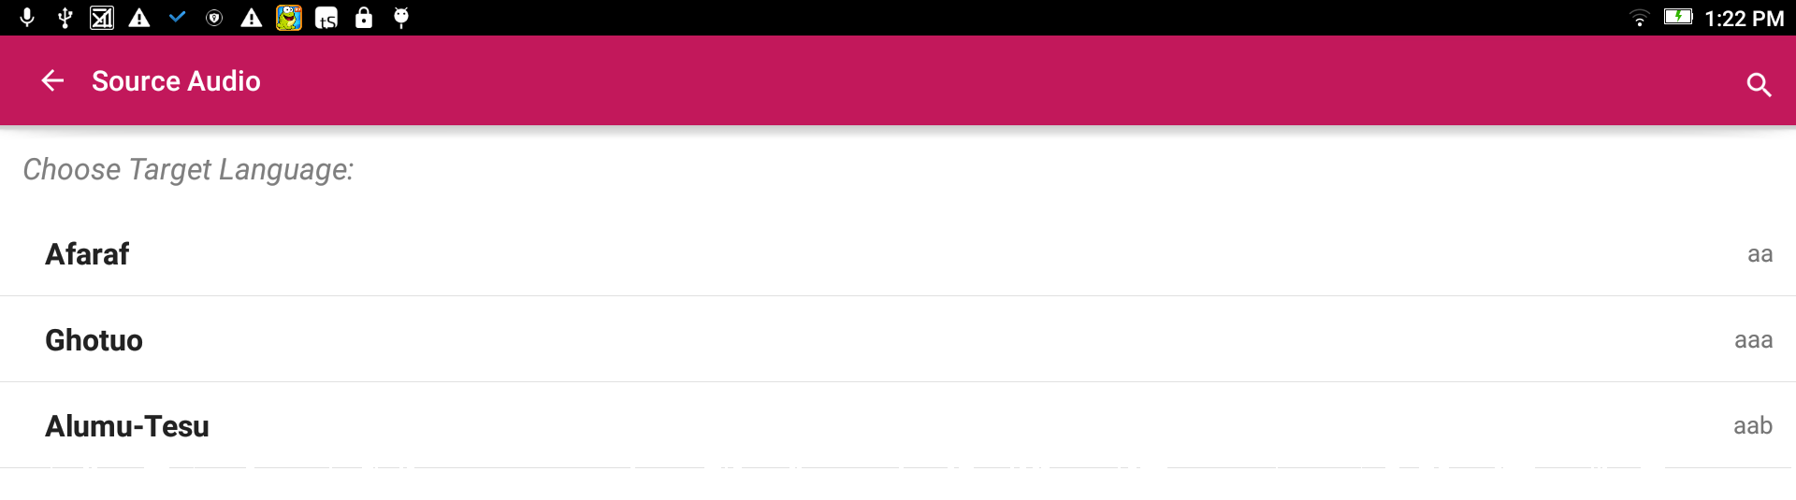
Source Audio Selection:
Search for the desired language by either:
Scrolling to the language name.
Clicking the magnifying glass and typing in the language name or language code.
Skip this step if not using a source text

Slide 11
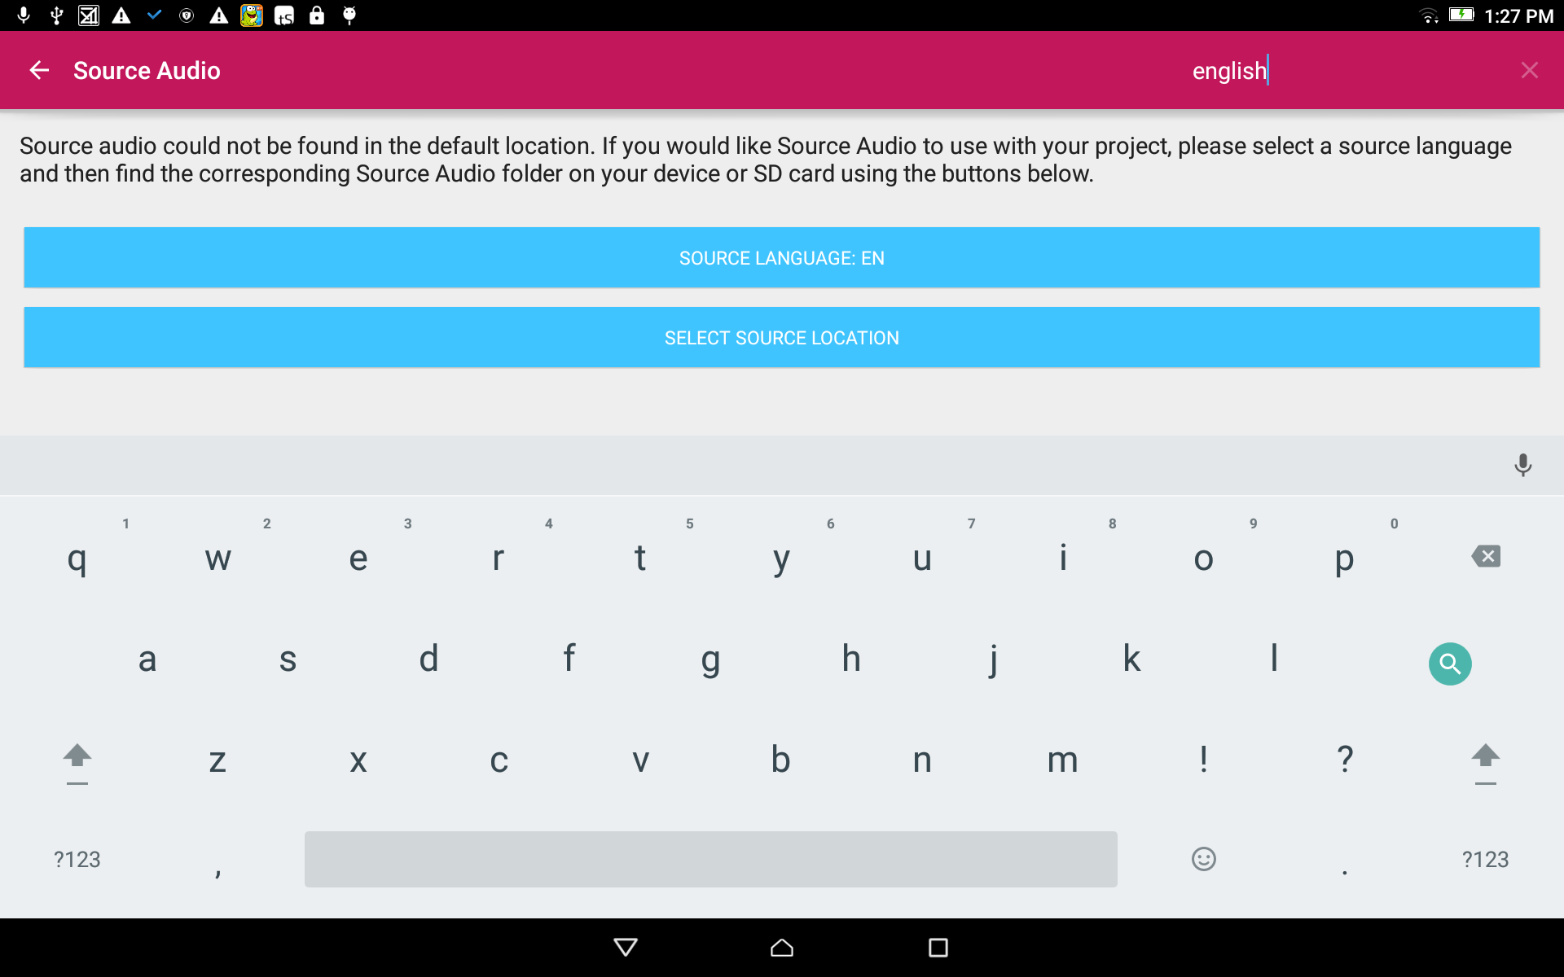
Source Audio Selection:
The language code now shows on the Source Language blue bar.
Tap on the bottom blue bar (Select Source Location).
Skip this step if not using a source text

Slide 12
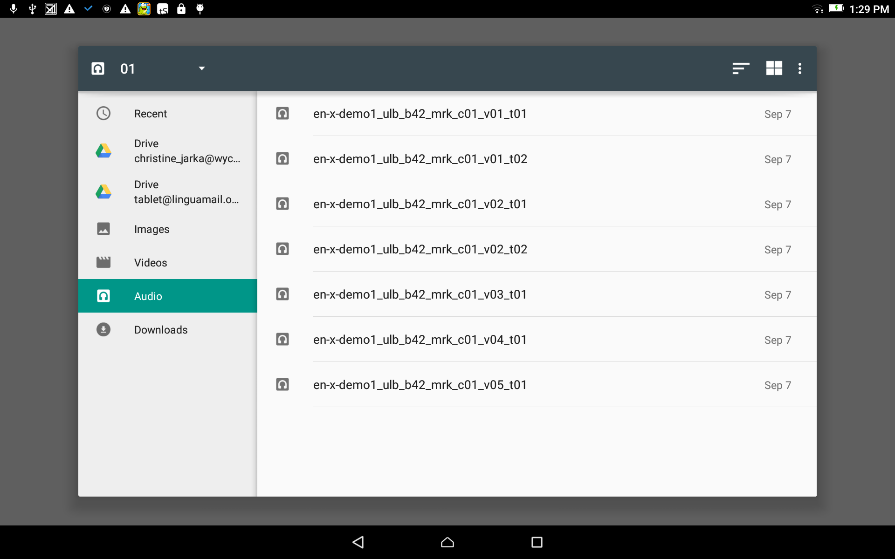
Source Audio Selection:
Use the File Manager to find and select the appropriate source file. (The facilitator will help with this.)
Skip this step if not using a source text

Slide 13
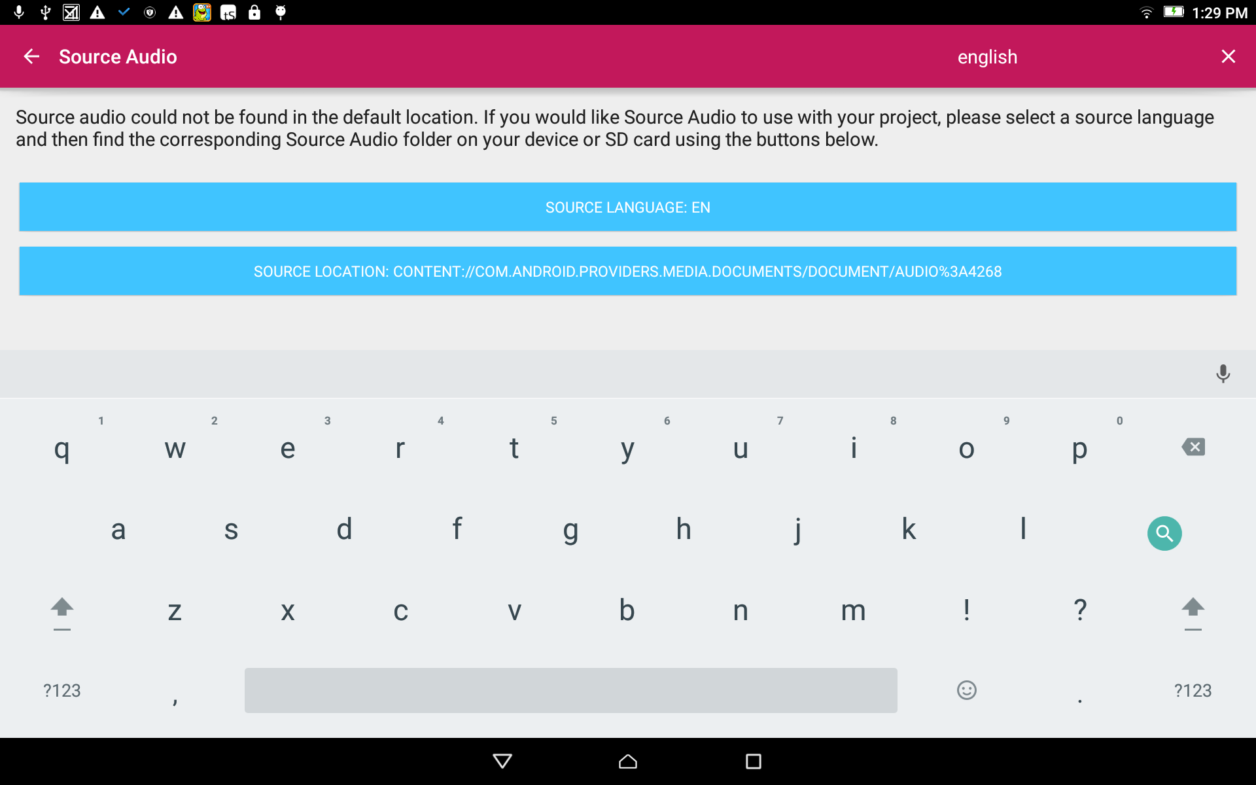
Source Audio Selection:
The source language file name now shows on the Source Location blue bar.
Close the keyboard.
Skip this step if not using a source text

Slide 14
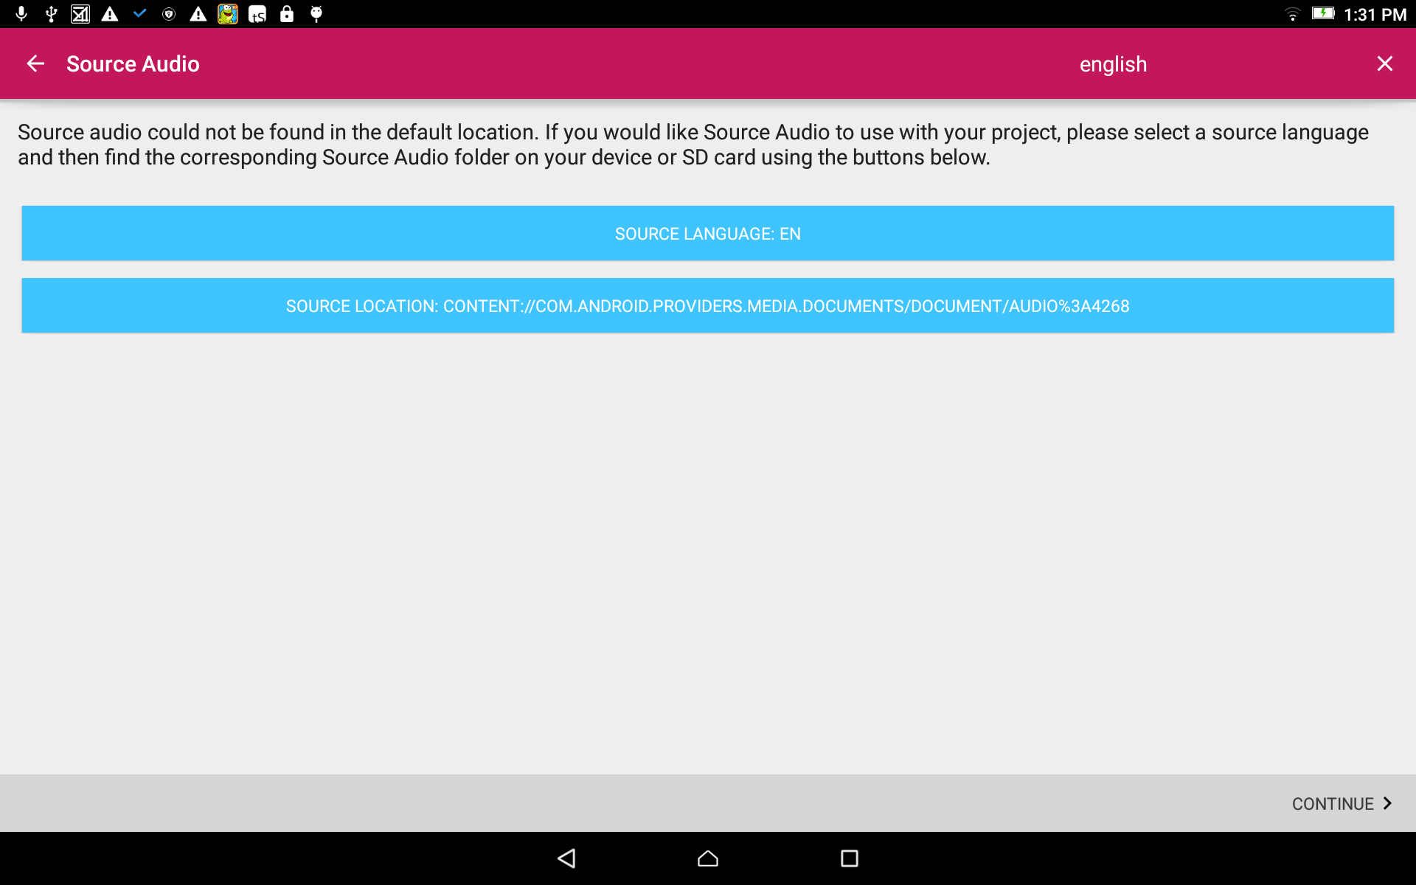
Source Audio Selection:
Tap on the CONTINUE link at the bottom right.
Notes:
Do not use navigation icons on this slide. Click anywhere on the screen.

Slide 15
Source Audio Selection:
Skip this step if there is no source audio.

Slide 16
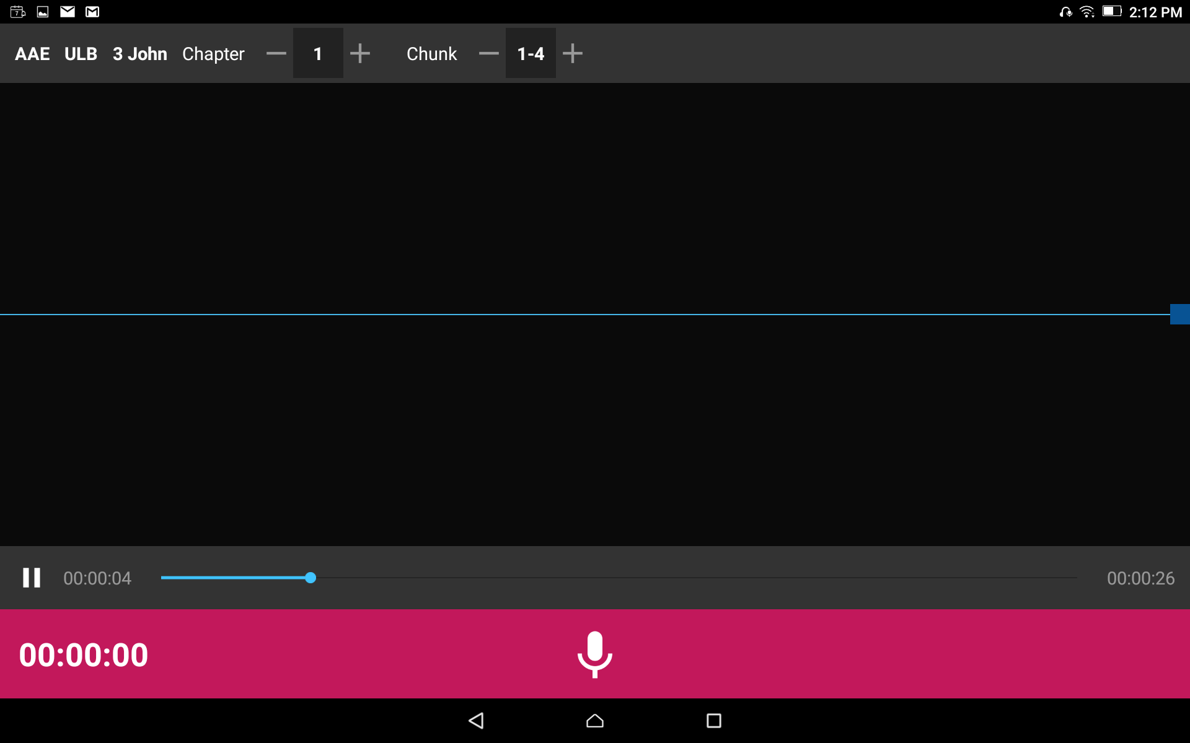
A New Project Opens:

